Slide 1
TrueTouch
Preliminary Design Review
Team 19

Slide 2
Our Team
Anthony Chan: EE
Alex Dickopf: CSE
Cameron Kluza: CSE
Jonathan Yip: CSE
Notes:
Alex

Slide 3
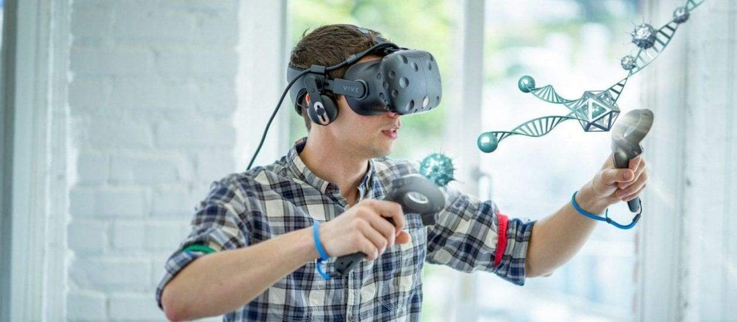
Virtual Reality
Transports you into a computer generated 3D space
Headsets such as HTC Vive and Oculus Rift
Provide visuals and sound but lack in other senses
Notes:
Alex

Slide 4
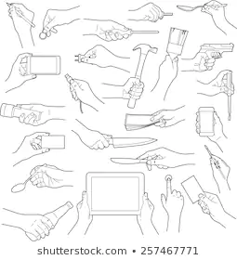
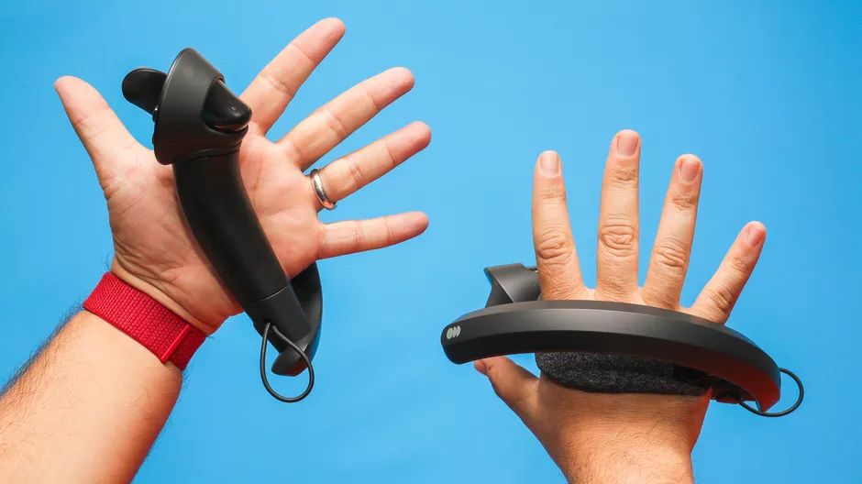
Problem Statement
VR lacks sensation of physical touch
Not realistic if your fingers can go through an object
Hand held controllers
Hand locked in a specific shape
Limited vibration areas
Improvement of immersion
Notes:
Highlight key aspects of problem statement
Alex

Slide 5
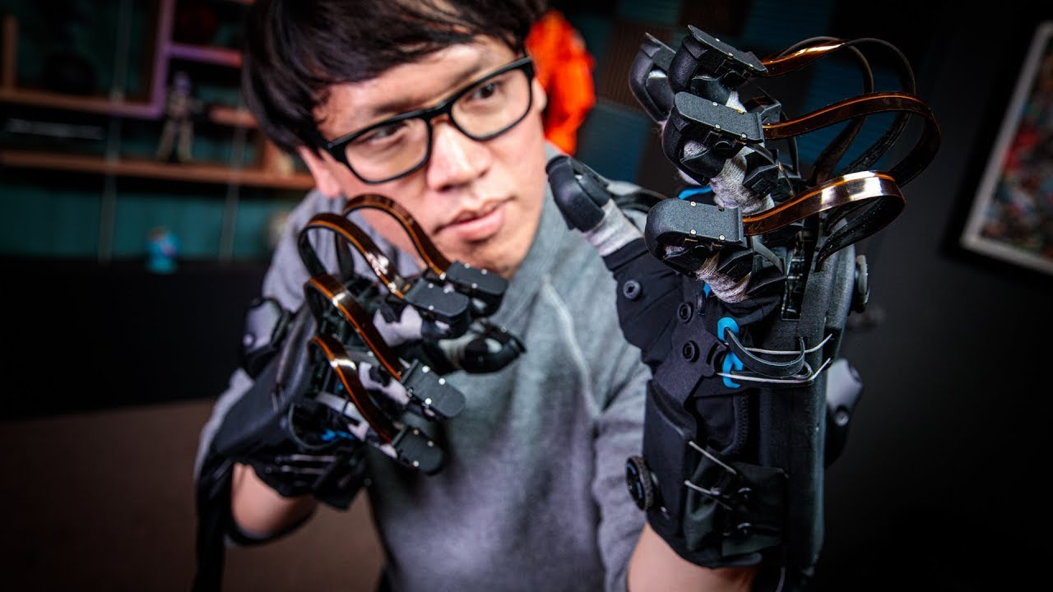
Haptic Feedback
Feedback to simulate physical touch
Different kinds of feedback
...such as force, vibrotactile, ...
Sense of impact and vibration
vibration motors (ERM, LRA, etc)
Sense of shape
Exoskeletons
Notes:
Note that most things on the market only provide vibration feedback
Mostly research and “upcoming” products for feeling shape
Very few solutions that do both
Alex
Explain types of feedback when speaking about this slide

Slide 6
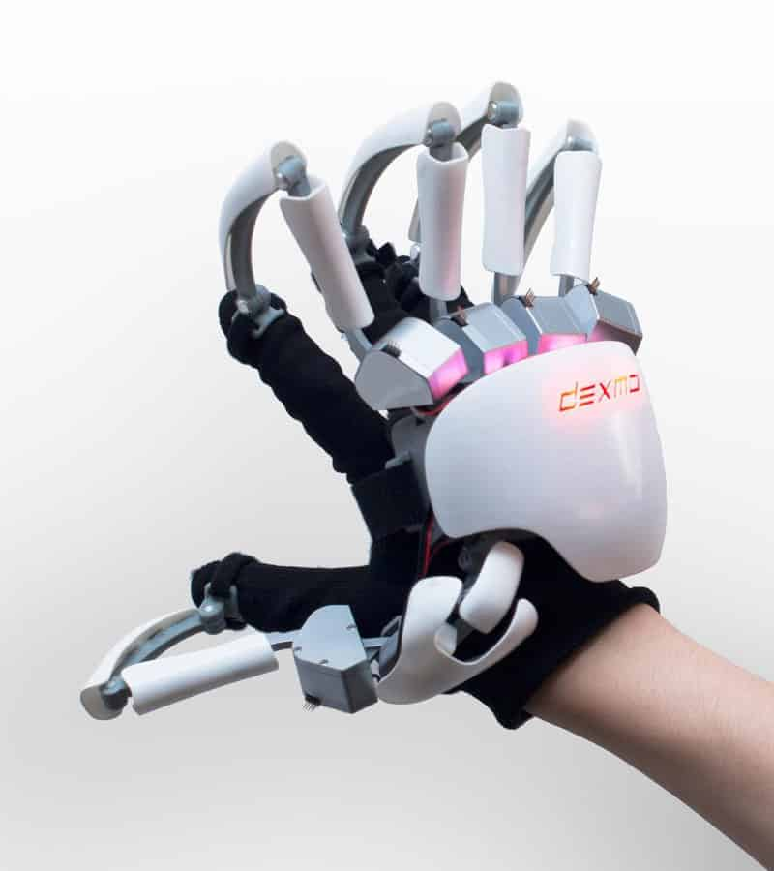
Existing Solutions - Dexmo
Provides sense of holding a shape...
… at cost of being very bulky
Exoskeleton frame: MechE vs. CompE/EE
Notes:
Alex

Slide 7
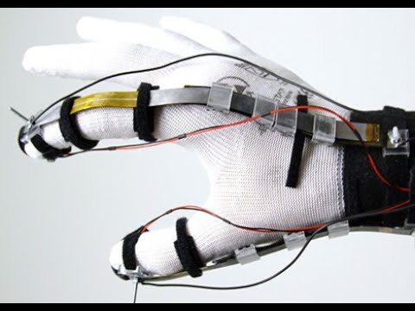
Existing Solutions - DextrES
Provides sense of holding a shape
Also lightweight
Flexible metal plates, magnetized to create friction
Only operates on pointer finger and thumb
Research-based (off-market)
Notes:
Alex

Slide 8
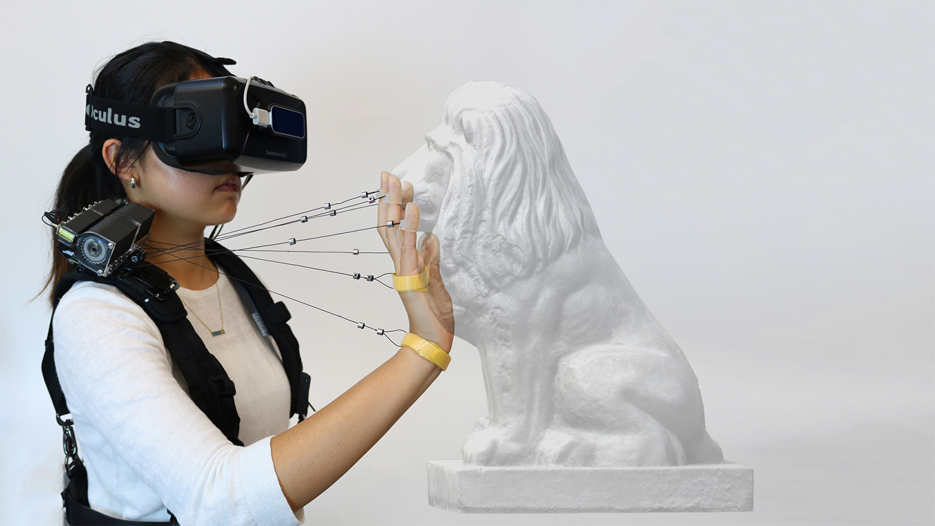
Existing Solutions - Wireality
Off-market, but low cost to produce (~$35)
Can imitate form of irregular shapes
Shoulder mounted, not mounted on arm or hand
Lacks vibrotactile feedback- cannot feel sense of impact against fingertips or hands
Notes:
Alex

Slide 9
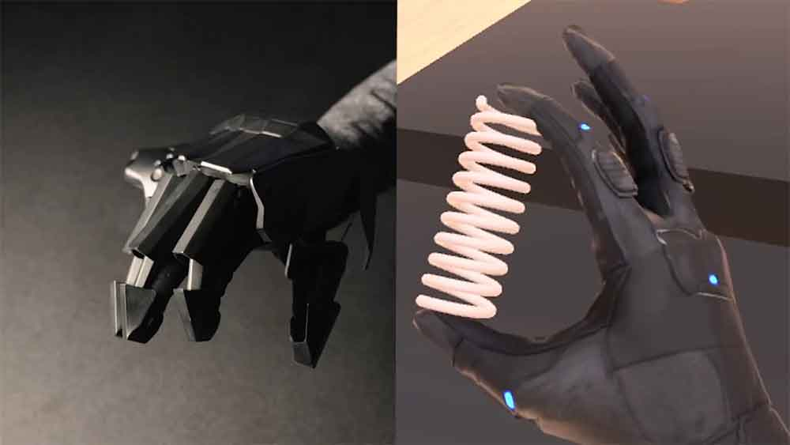
Existing Solutions - VRGluv
Goal similar to TrueTouch
Simulates both shape and impact
Availability limited only to industrial use cases
Notes:
Alex

Slide 10
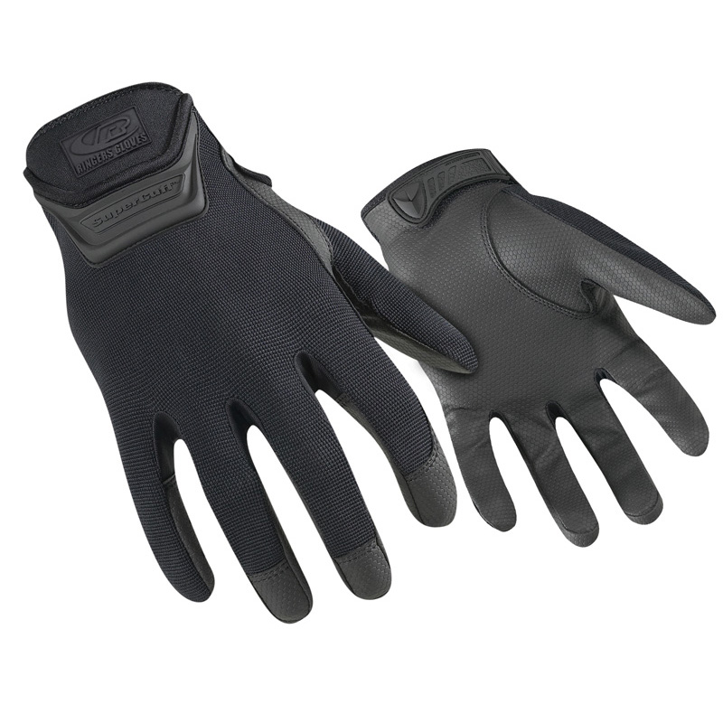
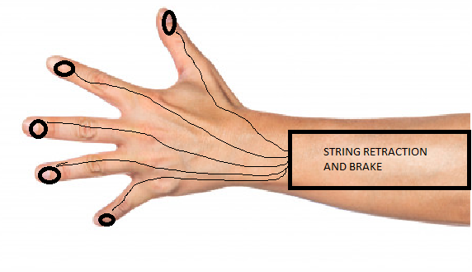
Proposed Solution: TrueTouch
Combining both: feeling of shape and impact
Controller free
Lightweight glove, extending onto the arm
Integrate with Vive Hand Tracking SDK
Ringer R507-09 Duty Gloves
Notes:
Jonathan
Moving on to our proposed solution. We want to create the sense of holding a shape and impact and put it in the form of a glove and forearm mount. We are planning on using the Vive Hand Tracking SDK for tracking the hand, so in order to do that, we had to have a low profile design so the Vive can recognize your hand. In the figure on the left, it shows a basic view of what our system will look like. For now, there is a black box containing all of the string retraction and braking on our forearm which has strings coming out of it leading to each finger. I will explain the black box in the next slide. Additionally, there will be ERM motors on the tips of the fingers and in the palm which i will get into later aswell. On the right is the glove that we are looking to use. It is non conductive, low profile and looks great. The idea is to interweave the string and have canals that route the strings along the back of the hand and fingers so there is nothing protruding out of the glove, making it hard for the hand tracking SDK to track your hand

Slide 11
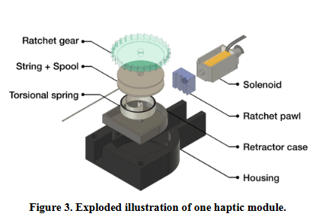
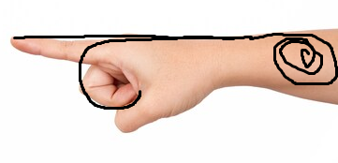
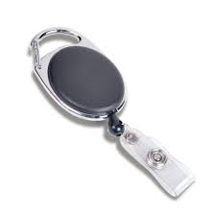
TrueTouch’s “Braking System”
System is mounted on the top of the forearm
Retractable string attached to the back of each fingertip
Length of the string attached to the back of the fingertips vary as you bend your finger
Limiting the length of a string along the back of your finger will limit how far you can bend
Using five ratchet and pawls to lock string length (inspired by Wireality)
Notes:
Jonathan
Perhaps the most complicated part of the diagram shown on the last slide is the black box containing the string retraction and braking system so I will go through the parts one by one. I will first explain why we use a string. This string idea is based on the idea that the length of your finger, is longer when it is bent compare to when it is straight. To better see this, i will do a demonstration through my video. As you can see, the length when my finger is bent is longer than when my finger is straight. If we can change the length of the string, we can control how much the finger is able to move.
However as you can see, there is some slack when i transition from bent to straight which is another issue.
To solve this, we thought of using a retractable string mechanism. The picture in the middle is probably something that you recognize. It is a keychain where it retracts the string when not in use. If we have a mechanism similar to this, we can constantly have a force pulling back the string, removing the slack. Now, obviously the concern with this is that the retraction mechanism is constantly apply a force pulling back on the finger back aswell. To relieve this concern, we can just have a weaker, torsional spring in our design so the pull back force is enough to pull back the string, but not enough to interfere with regular finger movement.
So putting these two mechanisms together we will get the device on the right. There is going to be a spool holding the string. That is attached to a gear. When the string is extended, the gear and spool will spin. When the desired length is reached, the solenoid will extend catching the gear and locking the string at the fixed length. The torsional spring as stated previously is responsible for rewinding the string back in the spool. This is the ratchet and pawl system we intend to build. This ratchet and pawl system is inspired by wireality
We will have one of these ratchet and pawl systems for each of our fingers and they will be located on the forearm mount. This way we can control fingers independently, so we can hold objects with irregular shapes and not just cylinders

Slide 12
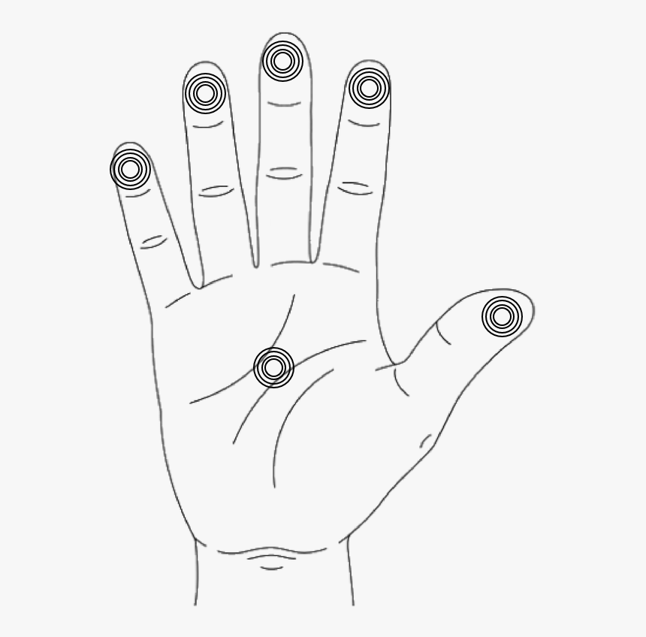
TrueTouch’s Vibrotactile System
Small Eccentric Rotating Mass (ERM) motors will provide vibrations, simulating impact
ERM motors will be placed on palm and each finger to provide sensation of impact against hand
Notes:
Jonathan
For TrueTouch’s Vibrotactile System, we will use Eccentric rotating mass motors. These motors will be placed at the tips of each finger and at the palm. The motors are responsible for giving you a vibration whenever an impact occurs in the VR world. Some examples of when these erm motors are being used are, if you are holding a drill, hitting a ball with a ping pong paddle. We will be able to control the intensity of the ERM motors so for example, you hit the ball very hard, the vibration will be harder than if you tapped the ball.

Slide 13
Requirements
Wireless system
Rechargeable battery of minimum 1 hour of life
Single glove with system weighs no more than 2lbs
Braking system and vibration activates within 100ms of seeing the object being touched in virtual world
Braking system able to withstand 20N of pulling force from finger-bending strength
Notes:
Jonathan
Here are some of the System specifications we set. First we wanted the system to be wireless. If we want to promote free movement of your hand and arm, it wouldn't make sense to have our system tethered to the computer or headset. That being said, we will also need a battery. We will have a rechargeable battery that will last at least 1 hour. This is because a session in VR usually lasts up to an hour. Next We want our system to be lightweight enough so it doesn't feel like there is something on your arm that you are carrying. We decided that 2lbs would be light enough that you wouldn’t notice. In terms of the haptics, we want the haptics to engage within 100ms of seeing event in VR.At times over 100ms is when the user will notice a latency, disrupting immersion. Lastly, we want the string braking system to withstand 20N of force. This is to give the sensation of sturdiness of the object and robustness of our brake design.The maximum amount of force a finger can produce is around 30-50N. We want to be able to hold back your fingers so you don't overcome the strength of the braking system and potentially destroy the braking mechanism altogether. However 30-50N is if you are really trying hard to squeeze an object. Under normal use, 20 newtons is adequate.

Slide 14
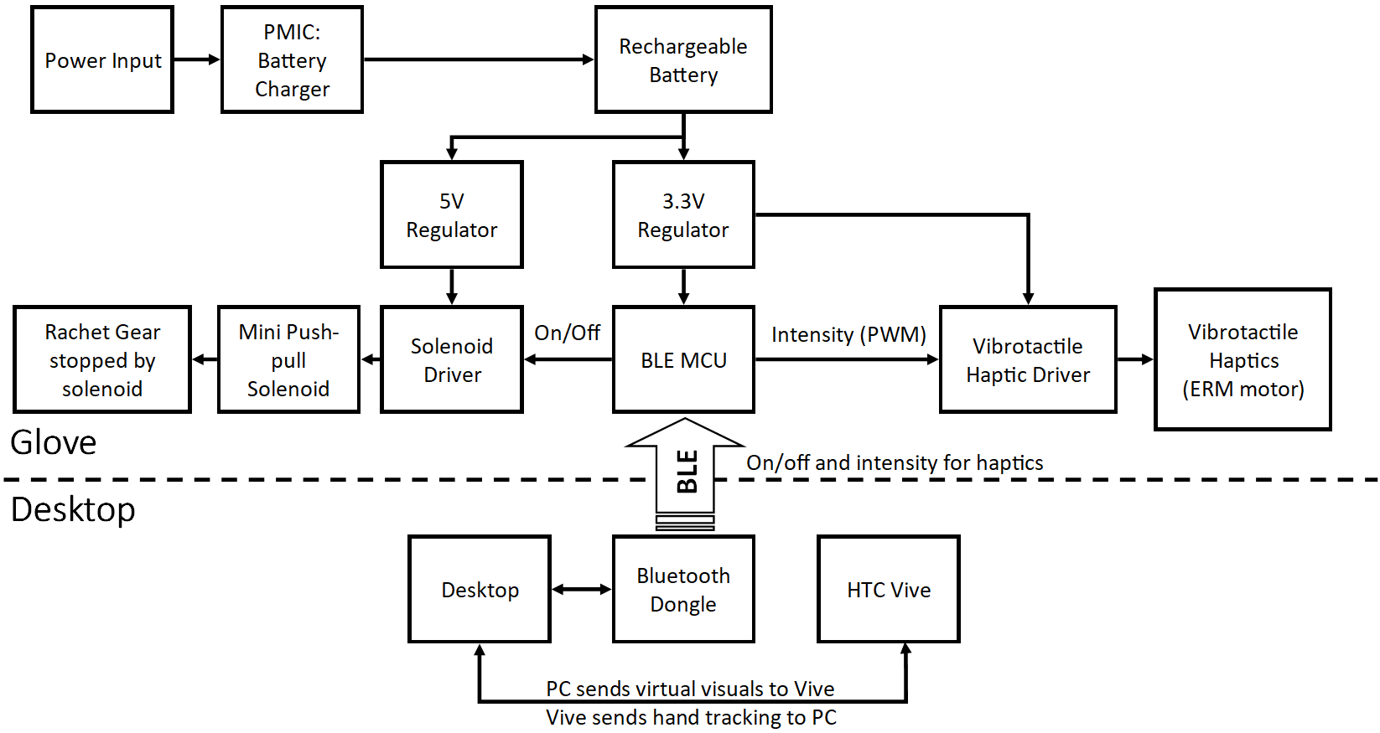
Hardware Block Diagram
Notes:
Anthony

Slide 15
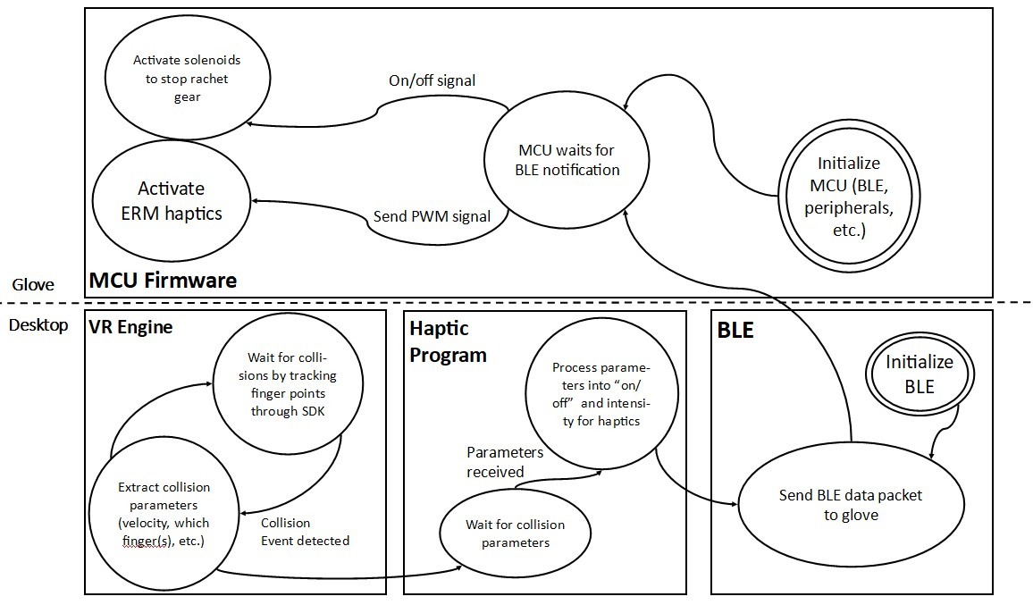
Software Block Diagram
Notes:
Anthony

Slide 16
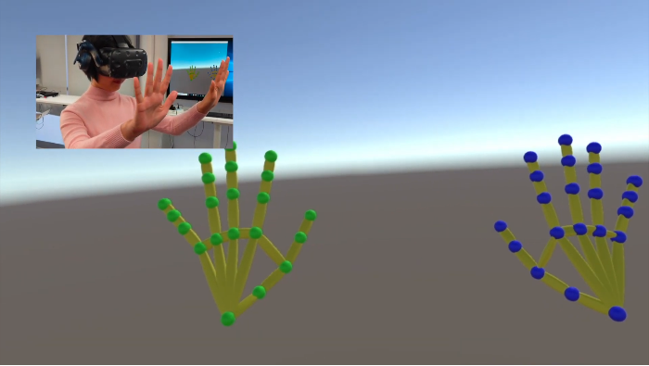
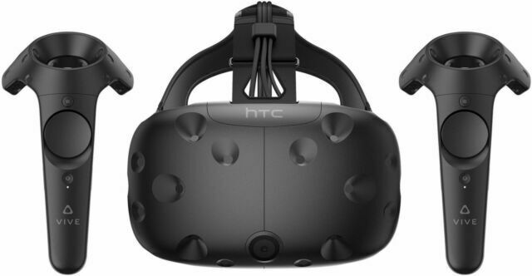
Components- HTC Vive
One of the most popular headsets
Used for testing
Needs to be connected to PC
VIVE Hand Tracking SDK
Notes:
Cameron
Mention why we picked Vive (accessible, hand tracking SDK)
Mention alternatives we considered?
Oculus (not accessible, but also has hand tracking)
Others (?)

Slide 17
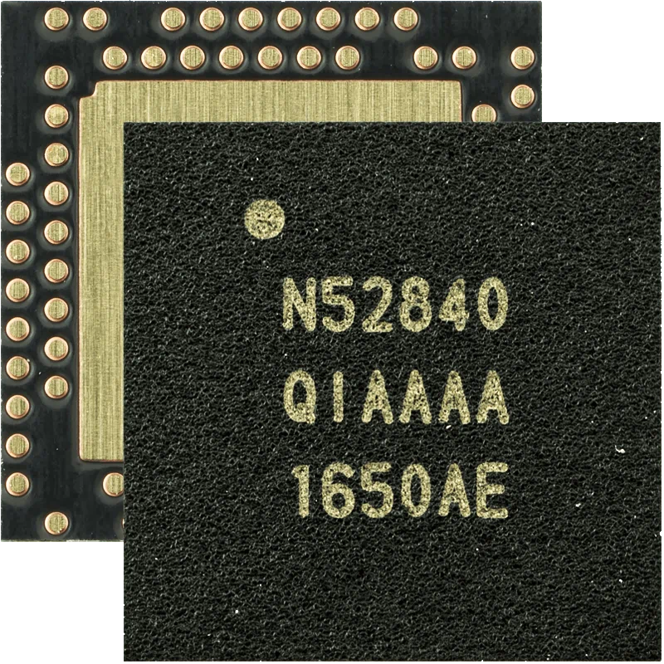
Components- Microcontroller
Necessary components:
BLE
5 GPIO to control solenoids (1 per finger)
6 PWM (1 per finger, 1 in palm)
Nordic’s nRF52 series
Supports Bluetooth 5
Easy routing of signals (e.g. PWM, GPIO can be routed to almost any pin)
Lots of existing software and hardware support
Notes:
Cameron
Why BLE over other wireless techs?
BLE is appropriately ranged, very common/ubiquitous on desktop, low power (we’re using a battery powered device)
WiFi is appropriately ranged, very common/ubiquitous on desktop, not low power
ZigBee/others can be appropriately ranged, less common on desktop, low power
Why hardware PWM?
Using hardware timers to do PWM will make software simpler and free CPU resources
Pins are 1 to power solenoids per finger, 1 to power ERM motors per finger, and 1 to power ERM motor in palm
Why nRF?
nRF: cheap, widely available (dev kits, modules for PCB integration, etc), has BLE, has lots of existing support
STM32WB: not as cheap, not as widely available, has BLE, has lots of existing support
Ambiq Apollo: reasonably cheap, not widely available, has BLE, does not have much support

Slide 18
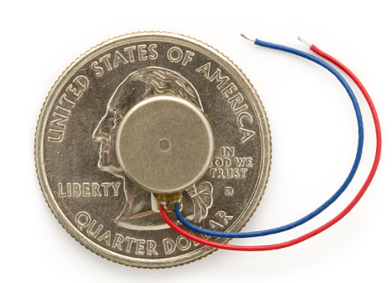
Components- Eccentric Rotating Mass Motor
SparkFun: Coin-sized vibration motors at the glove fingertips
Responsible for providing physical haptic feedback to the user throughout different parts of the hand
Low-cost - $2.15 per motor
Compact and low input voltage (requires input of 2V-3.6V)
Low input needed, as it “shakes crazily at 3V”
Notes:
Cameron
Why ERM?
ERM: small, low cost, simple driving circuitry (diode + transistor), same driving voltage as logic level
LRA: small, low cost, more complex driving circuitry (needs AC - needs special driving IC)
Anything else?

Slide 19
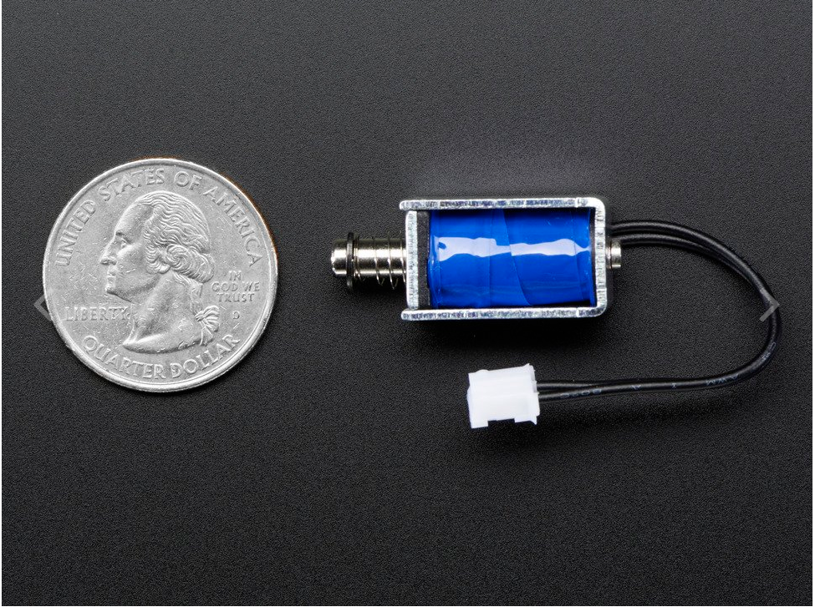
Components- Brake
Push-Pull Actuator with solenoid
Adafruit: Mini Push-Pull Solenoid - 5V, 1A
Compact, fast, low-cost
Notes:
Cameron
Push-pull solenoid:
Relatively small, high power but only needs to be activated in small bursts (mechanical part latches while user is pulling down on it), affordable, relatively simple driving circuitry
Other solenoids: much higher power/voltage requirements
This has also been proven to work in the Wireality project

Slide 20
MDR Deliverables
Single glove with implemented braking system and vibrotactile system
Don’t have access to VR headset immediately
Focus on hardware component; less on syncing VR visuals
Microcontroller interfaced with BLE and power systems
Windows BLE program to communicate w/ MCU
Power supply will be wired (micro-USB to MCU); wireless supply to be implemented for FPR
Control vibration and braking system on individual fingers through computer using “dummy data”
Different intensities and movement threshold of finger
Notes:
Anthony

Slide 21
Evaluation of Prototype Cost
Notes:
Anthony

Slide 22
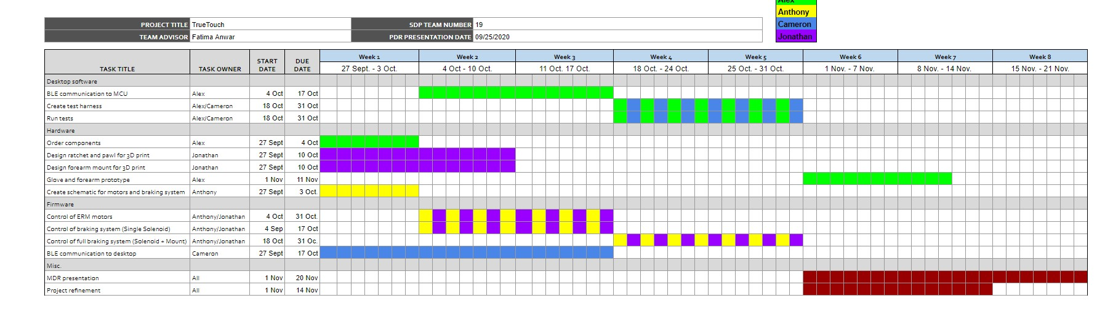
Project Management - Gantt Chart
Notes:
Anthony

Slide 23
Project Management - Additional Team Responsibilities
Team Coordinator: Anthony Chan
Altium Lead: Cameron Kluza
Budget Management Lead: Alexander Dickopf
Website Management: Jonathan Yip
Notes:
Anthony

Slide 24
Thank you!
Questions?

Slide 25
References
Bhaptics. (n.d.). Retrieved September 21, 2020, from https://www.bhaptics.com/
Fang, C., Zhang, Y., Dworman, M., & Harrison, C. (2020, April). Wireality: Enabling Complex Tangible Geometries in Virtual Reality with Worn Multi-String Haptics. In Proceedings of the 2020 CHI Conference on Human Factors in Computing Systems (pp. 1-10).
Force Feedback Haptic Gloves for VR Training. (n.d.). Retrieved September 21, 2020, from https://www.vrgluv.com/
Hinchet, R., Vechev, V., Shea, H., & Hilliges, O. (2018, October). Dextres: Wearable haptic feedback for grasping in vr via a thin form-factor electrostatic brake. In Proceedings of the 31st Annual ACM Symposium on User Interface Software and Technology (pp. 901-912).
VIVE Hand Tracking SDK (Early Access). (2020, July 31). Retrieved September 22, 2020, from https://developer.vive.com/resources/vive-sense/sdk/vive-hand-tracking-sdk/.
Mikhalchuk March 28, D. (2017, March 28). What is Haptic Feedback (Haptics)? Retrieved September 24, 2020, from https://teslasuit.io/blog/haptic_feedback/

